Slide 1


MedMinder
Problem Statement: ER is having long wait times. Deploy a digital solution for it
By: Sri Kiran Pramoda Rani:

Slide 2
User Persona: David's Urgent Health Concern
Name: David Miller, 42, Software Developer, Austin, Texas.
Situation: Experiencing severe abdominal pains, unable to secure a timely doctor's appointment, And ER waiting line is big. feeling upset with the healthcare system.
Needs: Immediate medical attention and a more responsive healthcare system.
Goals: To quickly find medical care and advocate for a system better equipped for emergencies.
Valued Solutions: AI symptom assessment tools, real-time doctor availability apps, emergency healthcare navigation services.

Slide 3
Solution: A Digital App(MedMinder)
Features:
2024-2026
Users input symptoms to receive immediate guidance on the urgency of their condition and recommended next steps.
Integration with healthcare providers to show available appointment slots, enabling immediate booking for urgent cases.
Assists users in finding the nearest urgent care centers or emergency rooms with the shortest wait times.
Option for users to connect with healthcare professionals via video call for urgent consultations.
Allows users to manage and share relevant health information (allergies, medical history) to expedite care during emergencies.
Uses historical data to provide users with estimated wait times at local emergency rooms and urgent care centers.

Slide 4
FEATURES:
Additional Features
Technical and Security Features
Support Features:
With insurance integration it helps users understand their coverage and find providers within their network to minimize out-of-pocket costs.
Enables users to log and manage their medications, including dosage reminders and interactions warnings.
Users can track their symptoms over time, useful for both acute and chronic conditions, enhancing communication with healthcare providers.
Design considerations for users with disabilities, including voice commands, large text, and screen reader compatibility.
User-generated reviews and ratings for doctors, clinics, and hospitals to guide others in their emergency care choices.
Access to a library of health articles, videos, and FAQs to help users understand potential health conditions and treatments.
Ensures user health data and personal information are securely stored and transmitted.
Robust authentication mechanisms, including multi-factor authentication, to protect user accounts.
Adherence to healthcare regulations and standards, such as HIPAA in the US, to protect patient privacy and data security.

Slide 5
Business Model and Revenue Streams:
Advertising: Generate revenue through targeted, non-intrusive advertisements from health and wellness-related companies.
Data Analytics Services: Sell aggregated and anonymized user data to institutions for healthcare research and policy-making.
Affiliate and Referral Fees: Earn fees by referring users to partner services, including pharmacies and telehealth providers.
Corporate Wellness Programs: Offer the app as part of corporate wellness packages, providing tailored health management tools for employees.
Licensing: License the app's technology or platform to other healthcare entities or regions for their use.

Slide 6
Unique Value Proposition
Immediate Triage and Direction: AI-driven assessment provides instant care recommendations, optimizing emergency care paths.
Real-Time Wait Time Predictions: Offers current wait times for ERs and urgent care, enabling informed patient decisions.
Seamless Healthcare Integration: Directly integrates with healthcare systems for efficient real-time appointment scheduling.
Personalized Health Navigation: Delivers custom health management and follow-up care plans to support ongoing patient health.
Comprehensive Health Management: Centralizes medical history and medication tracking for accessible, informed care decisions.
Enhanced Communication with Healthcare Providers: Facilitates direct patient-provider communication, improving healthcare response and clarity.
Community and Support: Creates a supportive network for sharing experiences and advice on navigating emergency health situations.

Slide 7
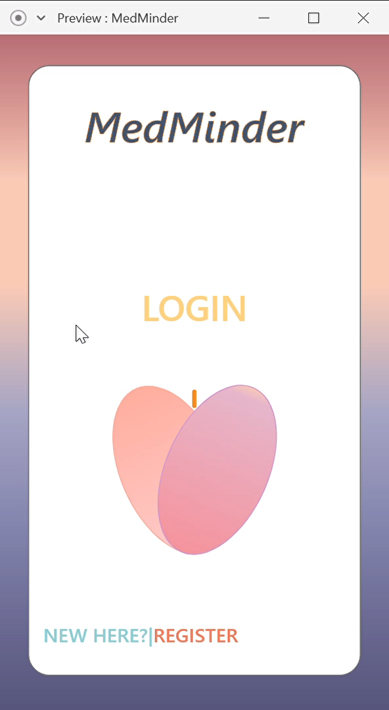
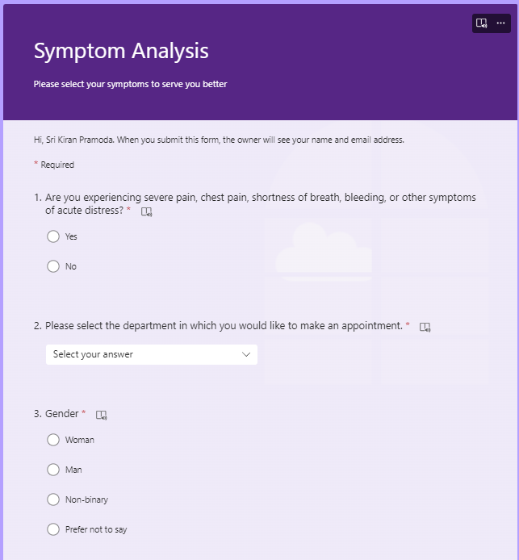
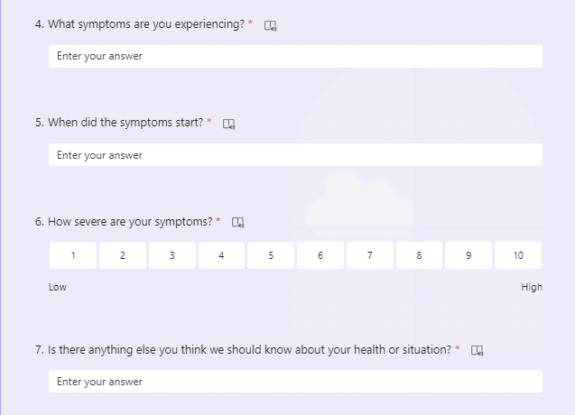
Prototype: (Watch the video)

